Slide 1
CIS5014_T1_PORT1 Portfolio
St20250265 – Leo Kukielka

Slide 2
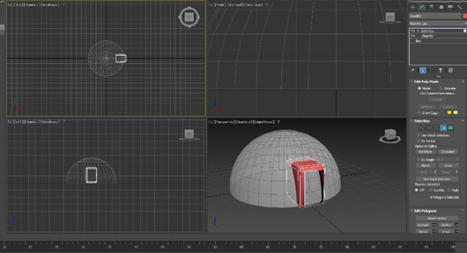
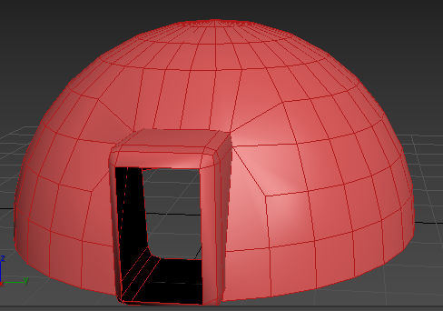
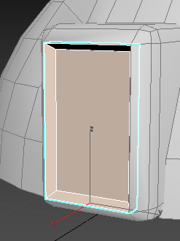
3D Modelling
I started the 3d modelling by making a sphere then removing the bottom to form a dome shaped building. I then combined a box which I had removed some polygons from to form an entrance.
I then created a door structure through using the bevel tool.

Slide 3
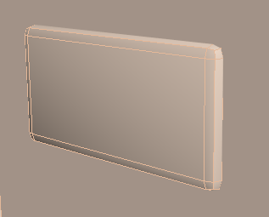
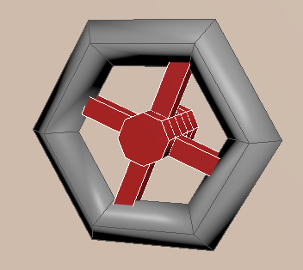
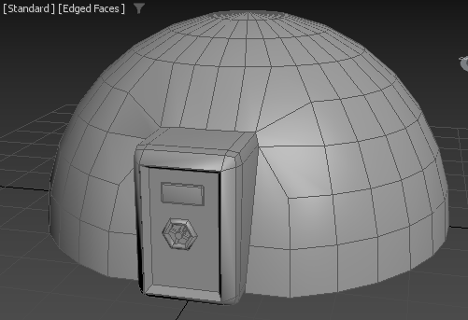
3D Modelling
After completing the door shape, I formed elements to the door with a chamfered box that represents a window. I created a circle vault door handle using a torus object with a cylinder in the middle and extrude some polygons to connect to the edges of the handle.
After completing the door and attaching everything together the first building was complete.

Slide 4
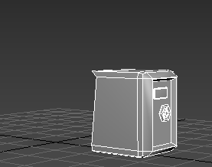
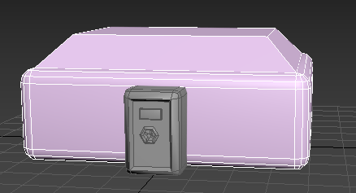
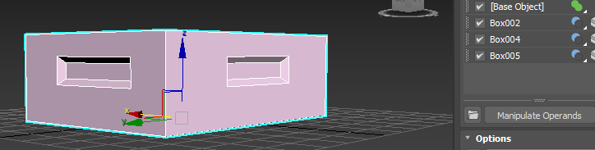
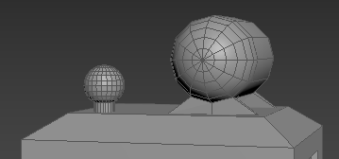
3D Modelling
Moving on the second phase of the building, I would retain the entrance from the previous building, then created a different shape.
I added what would be windows by using the Boolean operand to create the shape I wanted and to have indent windows on all sides of the building.
Finally, I added some elements to the top of the building so that it was more unique than the previous one.

Slide 5
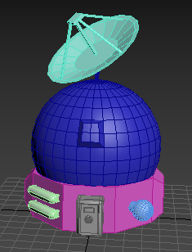
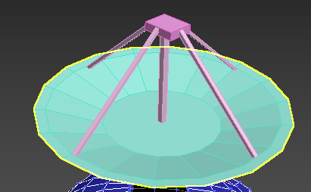
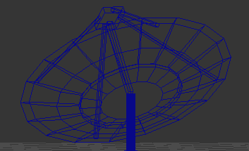
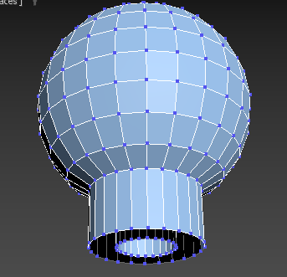
3D Modelling
For the third phase of the building, I retained the propane tank and made them smaller to add to the front, I added some bevelled windows to the side of the building and in the sphere above.
I created a satellite by starting with a thin cylinder and using the bevel, extrude and scale modifier to get the results I wanted to create a dish shaped object. I then created some elements above the dish to make it look for distinct.

Slide 6
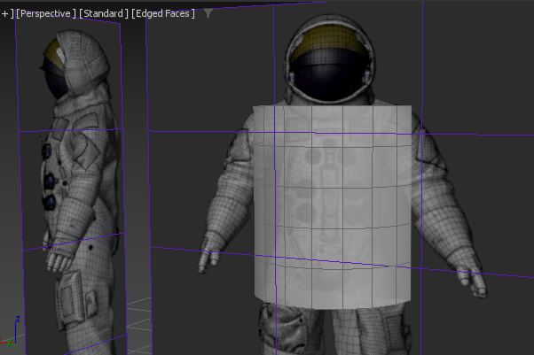
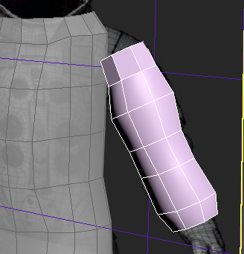
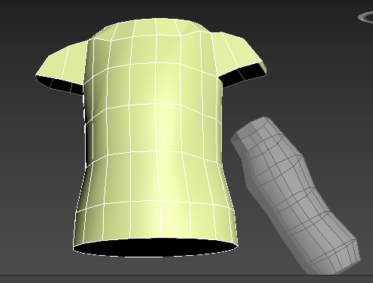
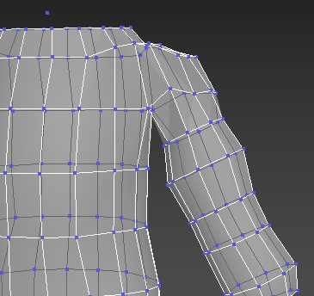
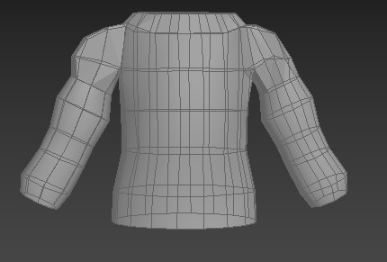
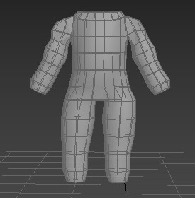
3D Modelling
I modelled a spaceman firstly getting a base with a picture I found and creating a torso and arm that would scale well with each other. After modelling the shoulder and the arm I attached them together by welding the vertices. I then created legs and did the same.

Slide 7
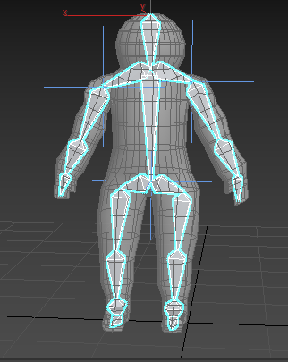
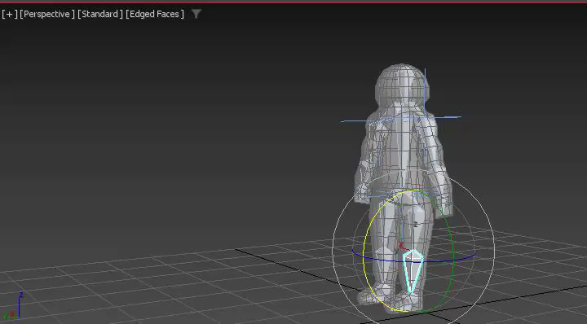
Animation
Firstly for the animation, I added a bone structure to my model and then proceeded to start animating a small hop to simulate hopping in low gravity.

Slide 8
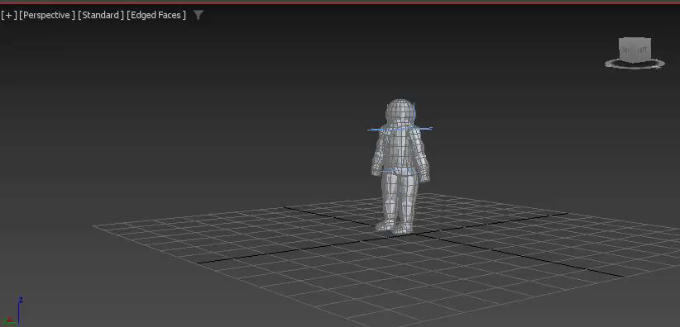
Animation
I then sped up the animation so the jump looked a bit more natural.

Slide 9
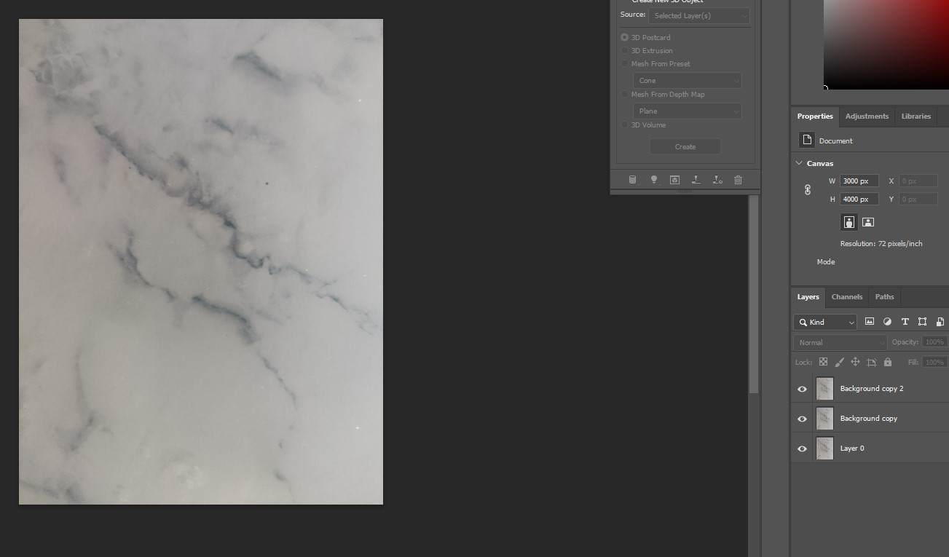
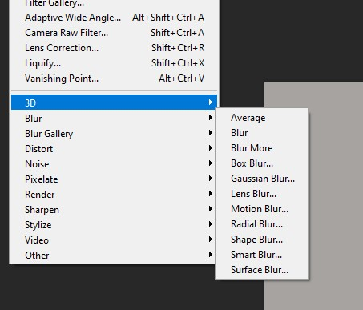
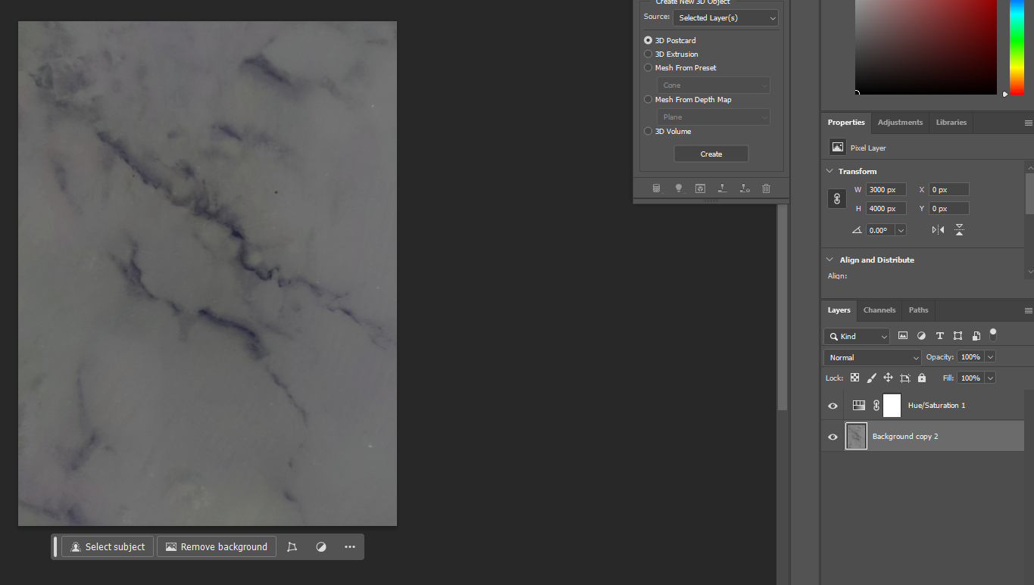
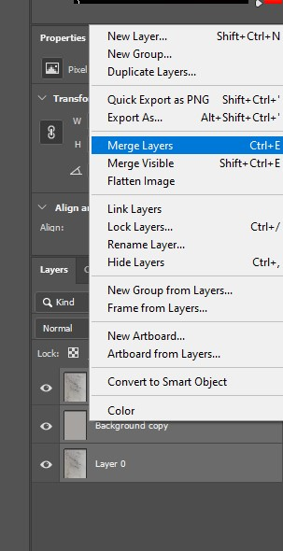
Textures
For the first texture I wanted to make a general texture that could be used for the moon bases, so I took a photo of tabletop and edited in photoshop.
Firstly I added an Average layer and then a High Pass layer. I then merged the layers and added hue/saturation modifier to leave the texture to look like this.

Slide 10
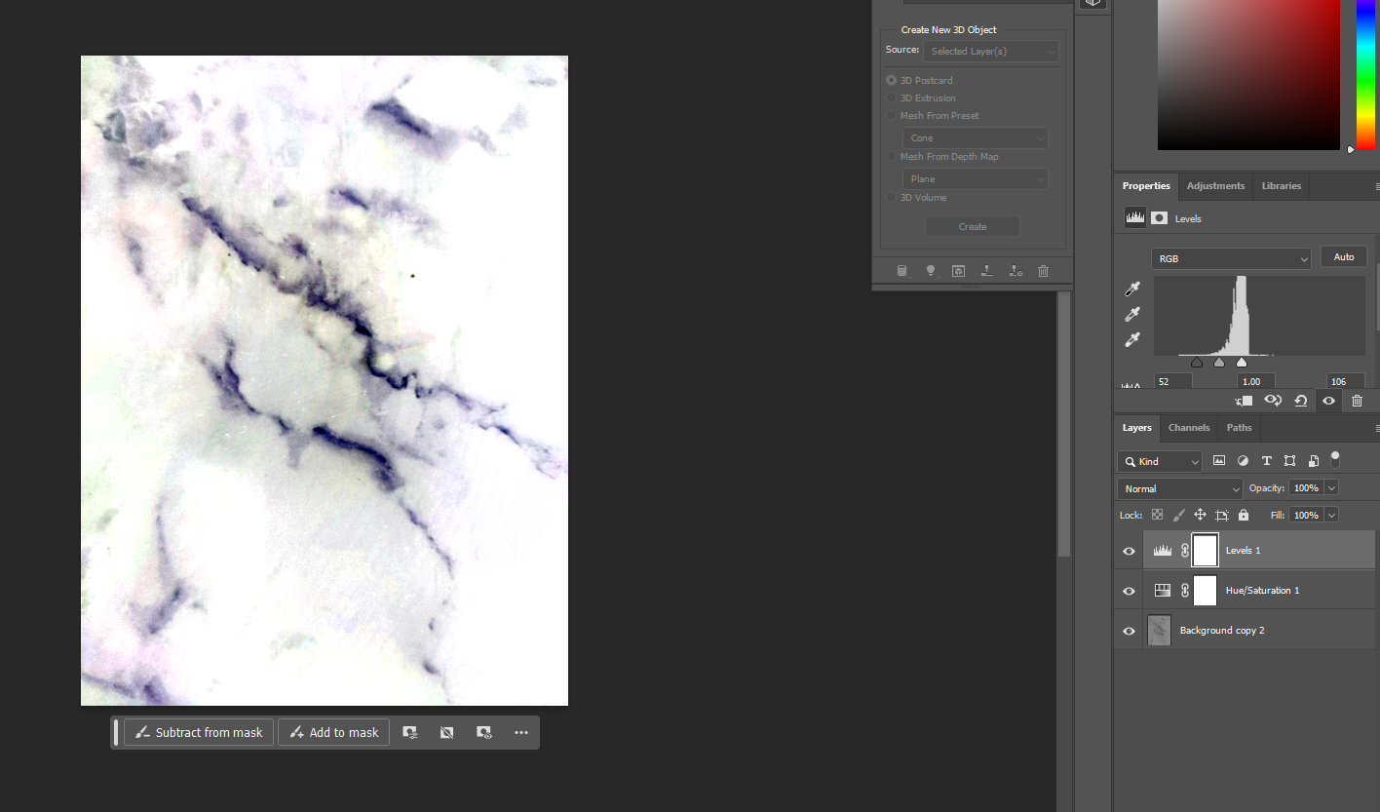
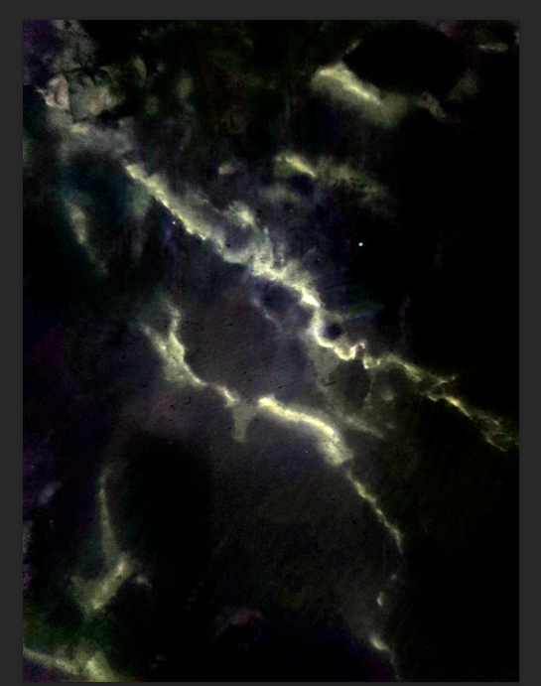
Textures
After applying a levels modifier, I was left with the white texture and decided to invert this texture to black in order to have 2 different textures to choose from.

Slide 11
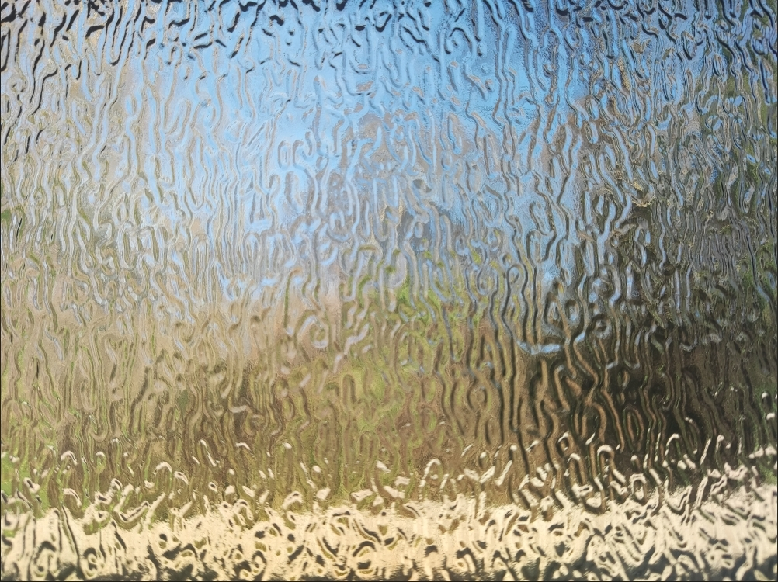
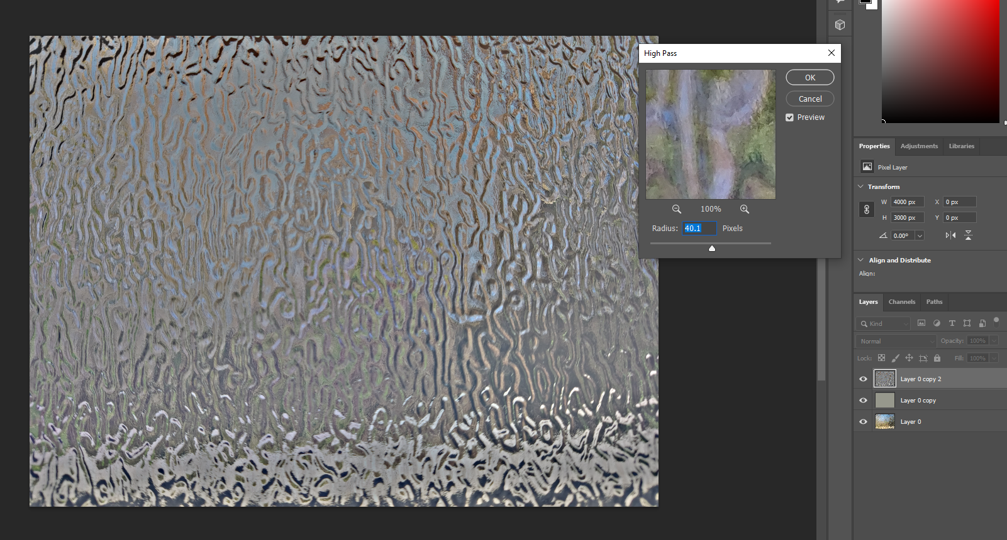
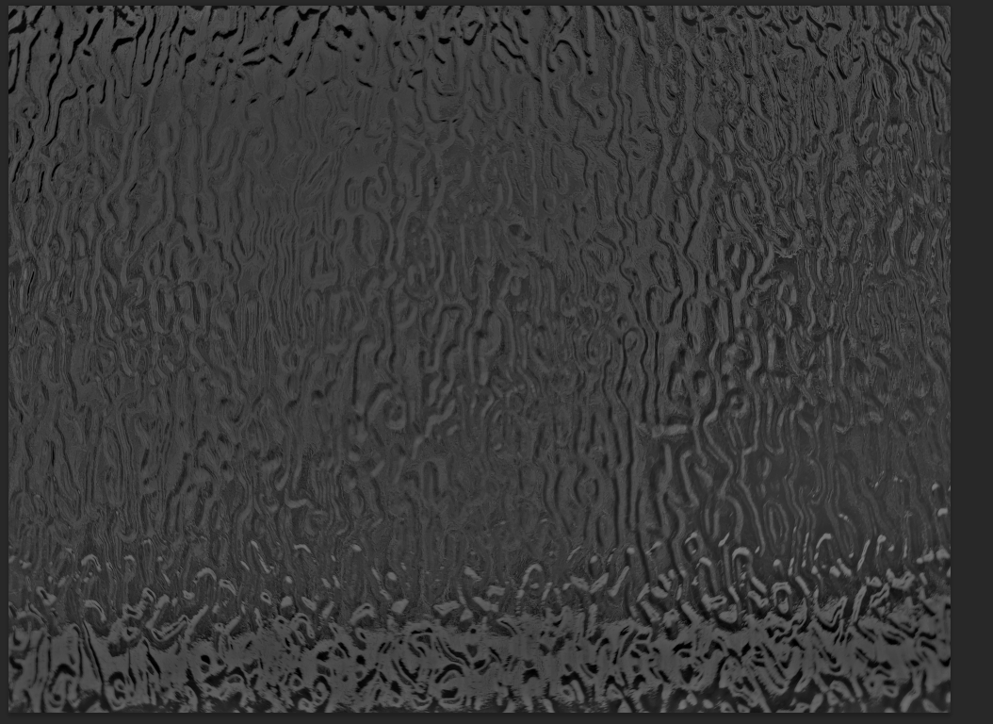
Textures
The same process for the glass texture but this time only needing 1 texture as I don’t want a different colour glass. The top image is an image I took and the bottom right is the finished texture.

Slide 12
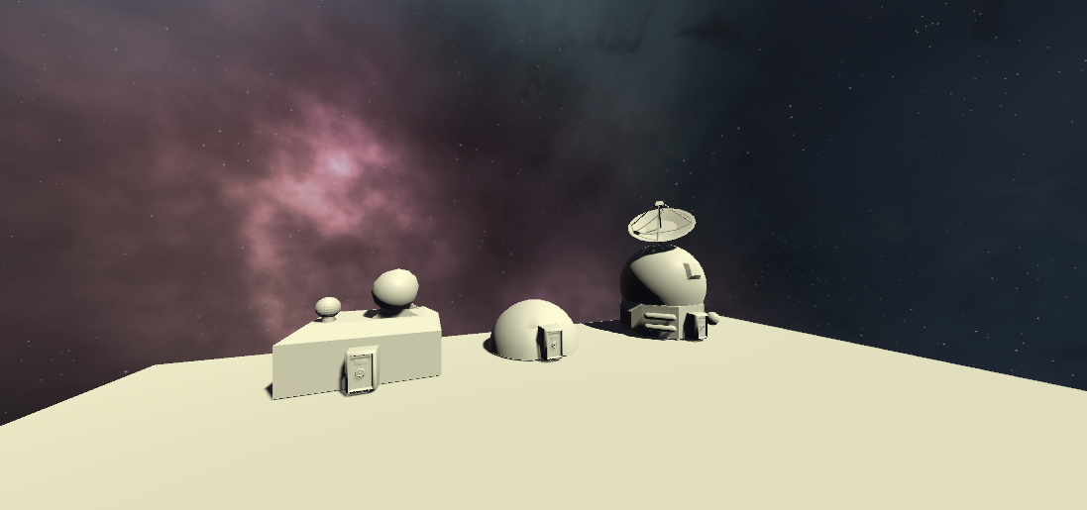
Level Design
Here’s how the assets would look inside of the unity game engine.
For the background I modified the skybox and used a space asset from the free unity store to symbolize that its on a planet.

Slide 13
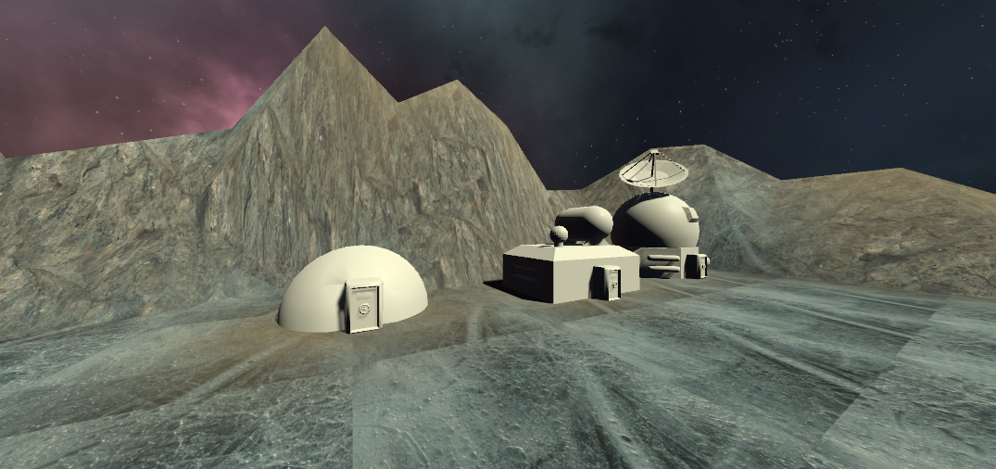
Level Design
https://gyazo.com/49c1dc2411f834eea3083f6cb00bb6a2
The level would have rocky mountains surrounding the placeable buildings which determines the area which the player can place the buildings.

